Slide 1
SENG 1000 - Software Engineering Foundations and Practice
-Sumati

Slide 2
Topics
Files
Introduction to File Input and Output
Using Loops to Process Files
Processing Records

Slide 3
Introduction to File Input and Output
Till now, data was stored in RAM (referenced by variables)
This data disappears once the program stops running.
For program to retain data between the times it is run, you must save the data
Data is saved to a file, typically on computer disk
Saved data can be retrieved and used at a later time
“Writing data to”: saving data on a file
Output file: a file that data is written to

Slide 4

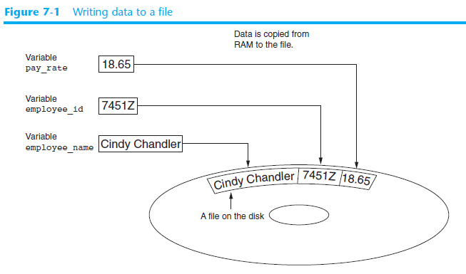

Slide 5
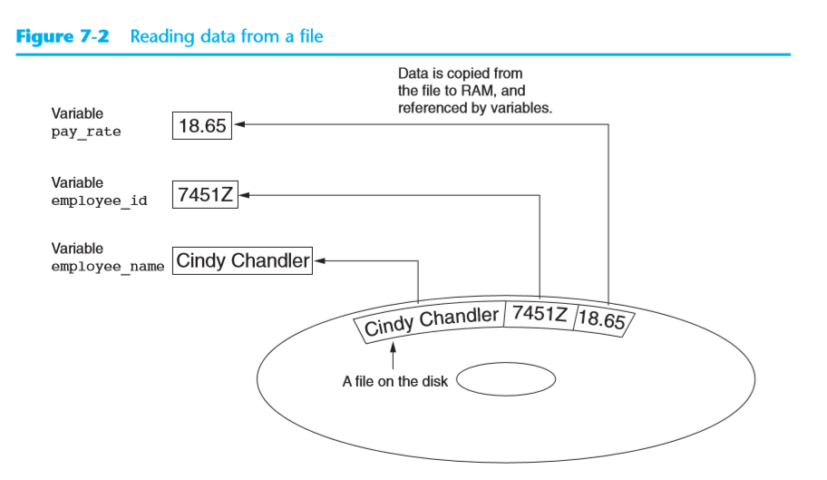

Slide 6
Introduction to File Input and Output (cont’d.)
“Reading data from”: process of retrieving data from a file
Input file: a file from which data is read
Three steps when a program uses a file
Open the file
Process the file
Close the file

Slide 7
Types of Files and File Access Methods
In general, two types of files
Text file: contains data that has been encoded as text
Binary file: contains data that has not been converted to text
Two ways to access data stored in file
Sequential access: file read sequentially from beginning to end, can’t skip ahead
Direct access: can jump directly to any piece of data in the file

Slide 8
Filenames and File Objects
Filename extensions: short sequences of characters that appear at the end of a filename preceded by a period
Extension indicates type of data stored in the file
Example: cat.jpg, notes.txt, and resume.doc
File object: object associated with a specific file
Provides a way for a program to work with the file: file object referenced by a variable

Slide 9
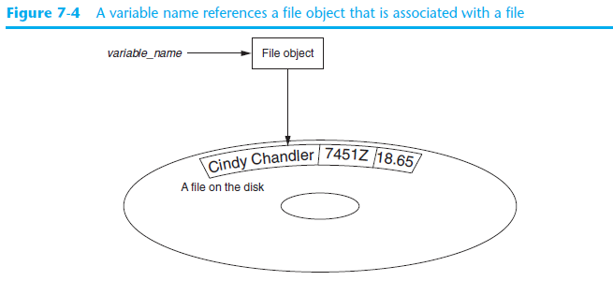
Filenames and File Objects (cont’d.)

Slide 10
Opening a File
open function: used to open a file
Creates a file object and associates it with a file on the disk
General format:
file_object = open(filename, mode)
Mode: string specifying how the file will be opened
Example: reading only (‘r’), writing (‘w’), and appending (‘a’)

Slide 11
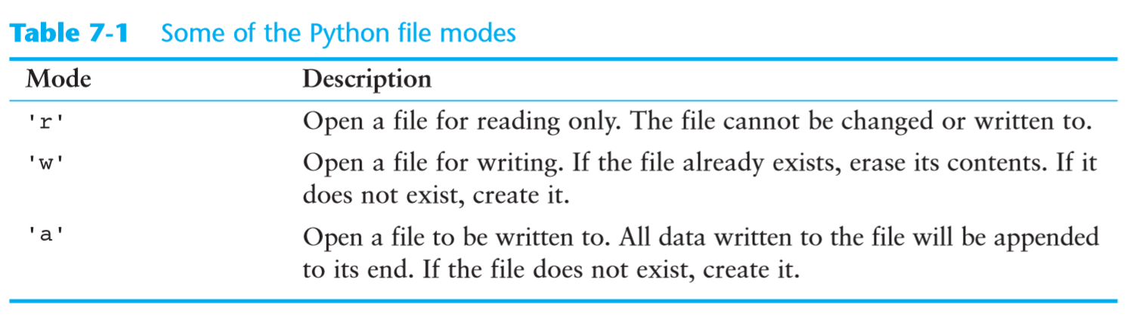
File Modes

Slide 12
Specifying the Location of a File
If open function receives a filename that does not contain a path, assumes that file is in same directory as program
If program is running and file is created, it is created in the same directory as the program
Can specify alternative path and file name in the open function argument
Prefix the path string literal with the letter r

Slide 13
Writing Data to a File
Method: a function that belongs to an object
Performs operations using that object
File object’s write method used to write data to the file
Format: file_variable.write(string)
File should be closed using file object close method
Format: file_variable.close()

Slide 14
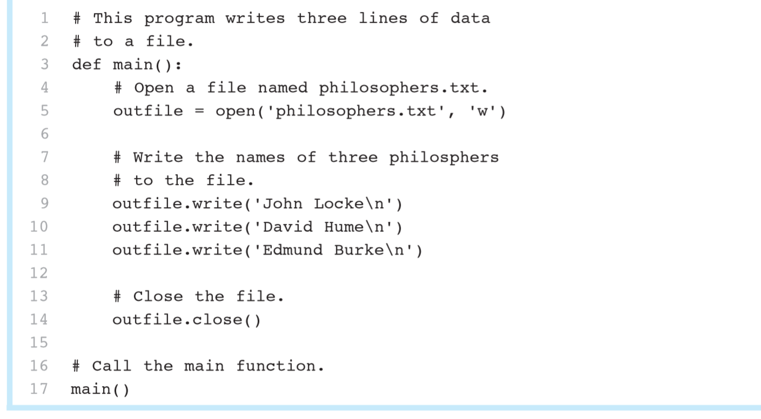
Writing Data to a File: Example

Slide 15
Reading Data From a File
read method: file object method that reads entire file contents into memory
Only works if file has been opened for reading
Contents returned as a string
readline method: file object method that reads a line from the file
Line returned as a string, including ‘\n’
Read position: marks the location of the next item to be read from a file

Slide 16
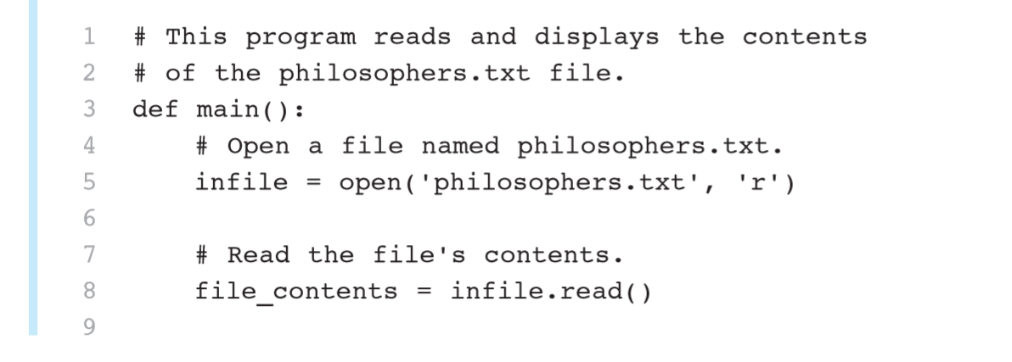
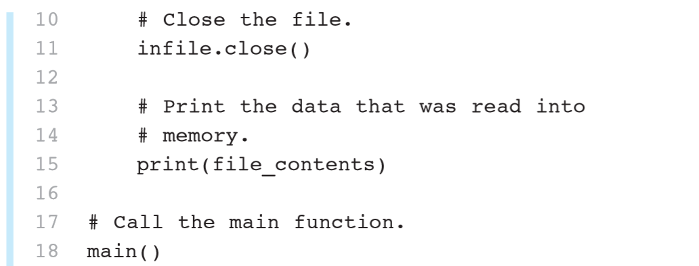
Reading Data From a File: Example

Slide 17
Concatenating a Newline to and Stripping it From a String
In most cases, data items written to a file are values referenced by variables
Usually necessary to concatenate a ‘\n’ to data before writing it
Carried out using the + operator in the argument of the write method
In many cases need to remove ‘\n’ from string after it is read from a file
rstrip method: string method that strips specific characters from end of the string
name = 'Joanne Manchester\n’
name = name.rstrip('\n’)

Slide 18
Appending Data to an Existing File
When open file with ‘w’ mode, if the file already exists it is overwritten
To append data to a file use the ‘a’ mode
If file exists, it is not erased, and if it does not exist it is created
Data is written to the file at the end of the current contents

Slide 19
Writing and Reading Numeric Data
Numbers must be converted to strings before they are written to a file
str function: converts value to string
Number are read from a text file as strings
Must be converted to numeric type in order to perform mathematical operations
Use int and float functions to convert string to numeric value
Example: outfile.write(str(num1) + '\n')

Slide 20
Using Loops to Process Files
Files typically used to hold large amounts of data
Loop typically involved in reading from and writing to a file
Often the number of items stored in file is unknown
The readline method uses an empty string as a sentinel when end of file is reached
Can write a while loop with the condition
while line != ‘’

Slide 21
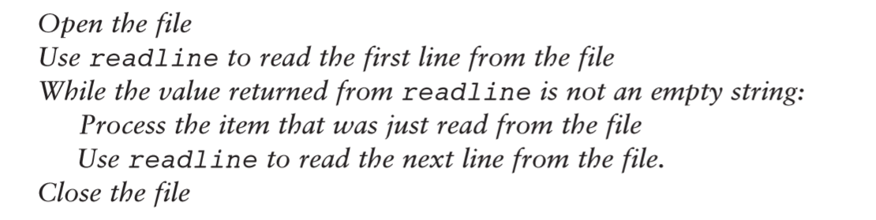
Using Loops to Process Files: Algorithm

Slide 22
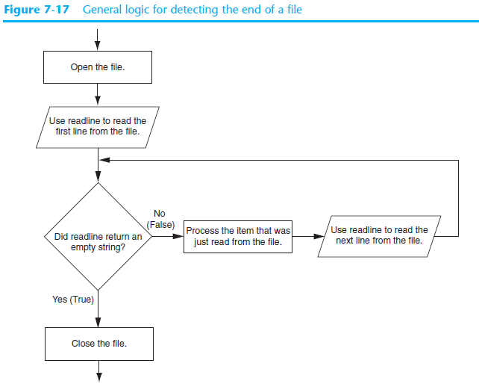

Slide 23
Using Python’s for Loop to Read Lines
Python allows programmer to write a for loop that automatically reads lines in a file and stops when end of file is reached
Format: for line in file_object:
statements
The loop iterates once over each line in the file

Slide 24
Summary
This chapter covered:
Types of files and file access methods
Filenames and file objects
Writing data to a file
Reading data from a file and determining when the end of the file is reached

